Slide 1
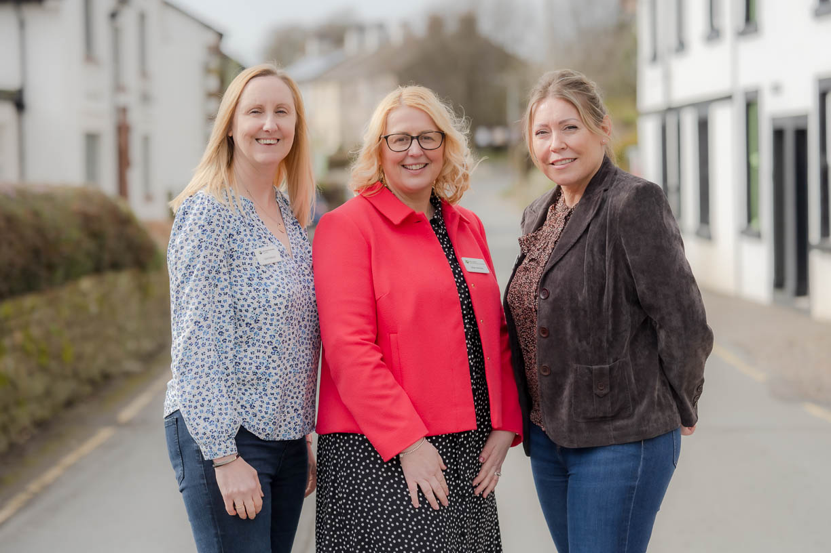

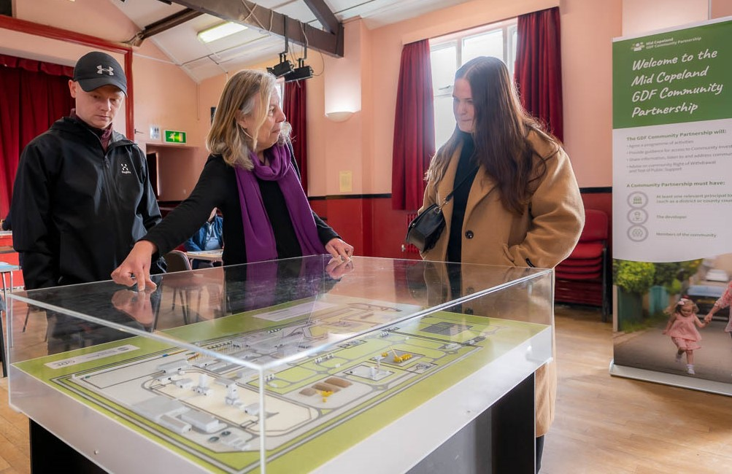
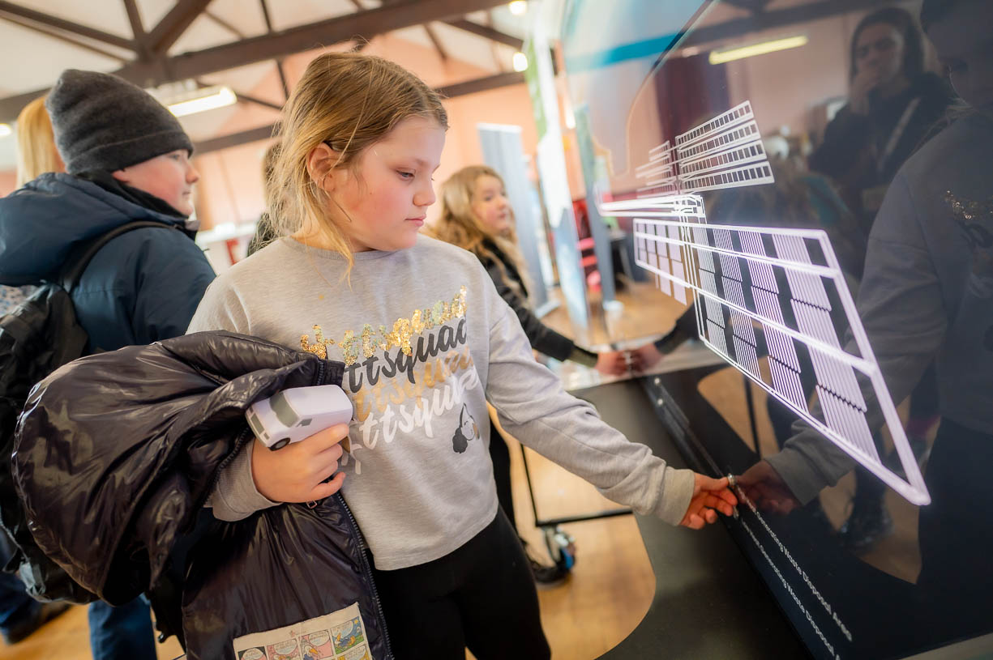

Slide 2
Summary
The Mid Copeland GDF Community Partnership held four exhibitions in Thornhill, Gosforth, Seascale and Drigg between 10th March – 18th March 2023.
107 people attended the events, with the community engagement team and subject matter experts responding to 94 questions and noting 52 statements and concerns from attendees.

Slide 3
Exhibitions held on the following dates:-
Friday 10th March 2023 – Thornhill Social Club
Total attendees: 22 (New: 13) CP Members: 6
Saturday 11th March 2023 – Gosforth Public Hall
Total attendees: 39 (New: 29) CP Members: 3
Friday 17th March 2023 – Windscale Club, Seascale
Total attendees: 22 (New: 7) CP Members: 2
Saturday 18th March 2023 – Drigg & Carleton Village Hall
Total attendees: 24 (New: 10) CP Members: 1

Slide 5
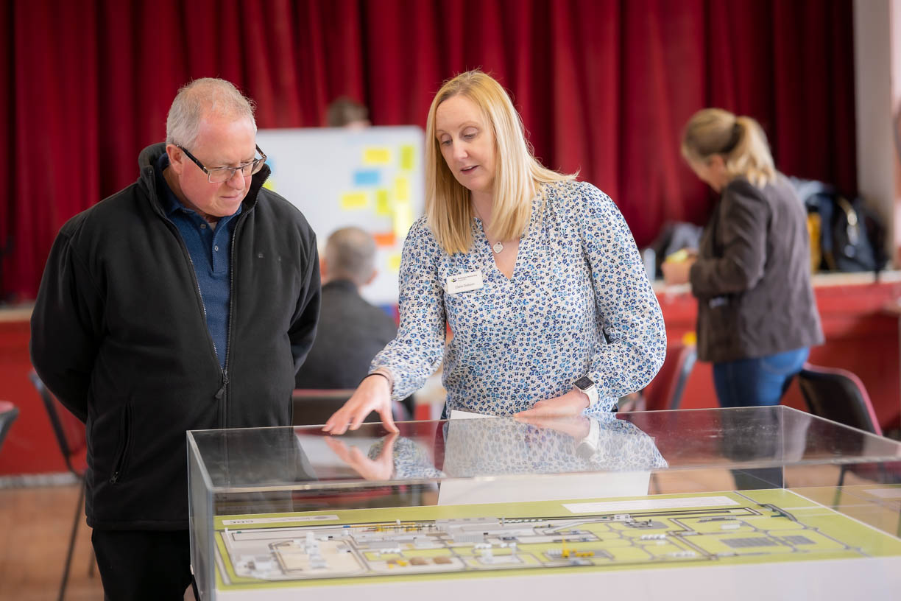
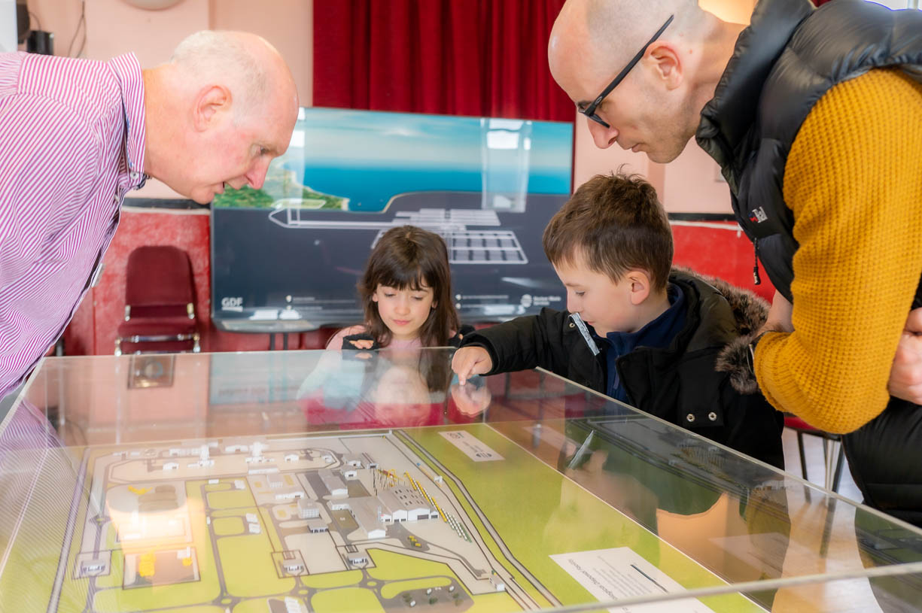
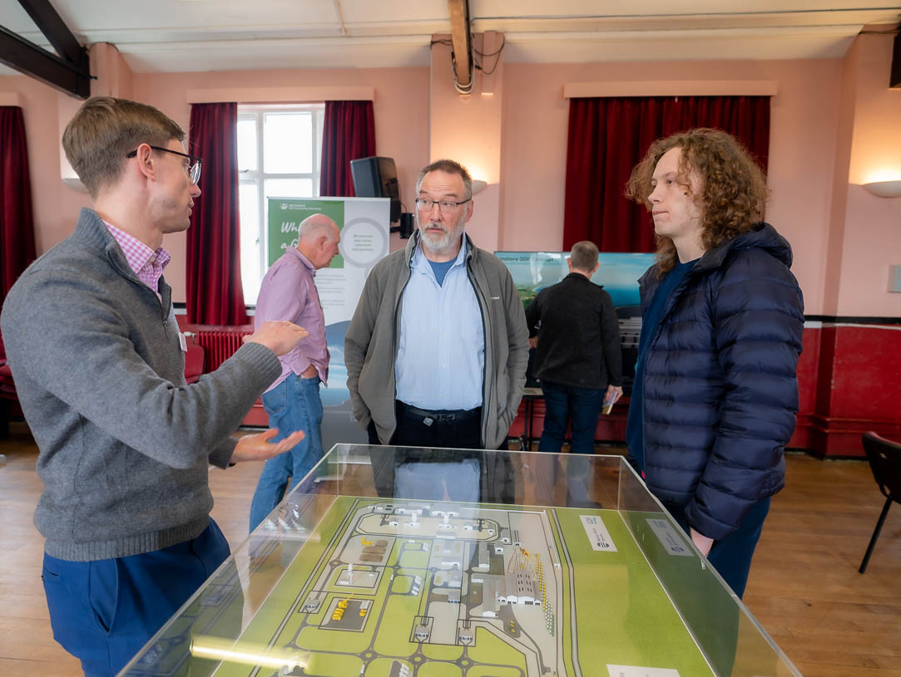

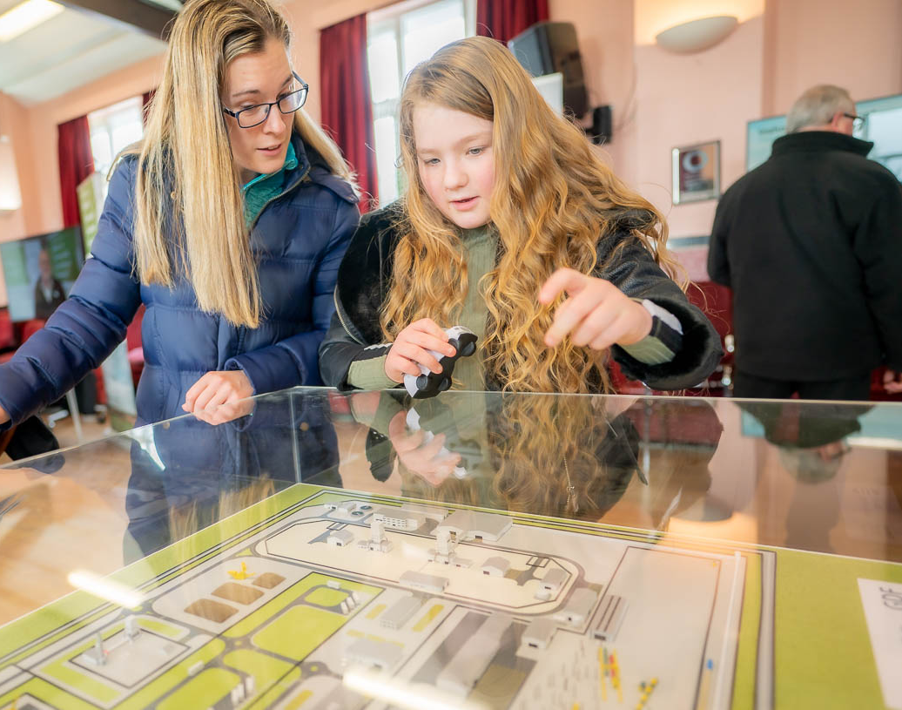

Slide 6
